Slide 1
Module XIX - Radioactive Waste Management
Iurii Iesypenko
State Nuclear Regulatory inspectorate of Ukraine
yesypenko@inspect.snrc.gov.ua

Slide 2
Lerning objectives
After completing this Module, the trainee will
be able to:
Explain in its own words the radioactive waste generation, treatment, storage and disposal process.
Understand the aim of the national radioactive waste policy and strategy.

Slide 3
Contents
1 Radioactive waste generation
2 Waste Classification System
3 Nature and Sources of Radioactive Waste
4 Treatment
5 Waste Packaging
6 Storage and Disposal
3

Slide 4
Radioactive waste
(based on IAEA glossary) - waste that contains or is contaminated with radionuclides at concentrations or activities greater than clearance levels (as established by the regulatory body).
The radioactive waste is produced in:
  medical, industrial, research facilities, nuclear facilities (nuclear power plants and fuel reprocessing facilities), uranium mining or naturally occurring.
Certain kinds of radioactive materials, and the wastes produced from using these materials, are subject to regulatory control.
Notes:
Based on IAEA glossary, waste that contains or is contaminated with radionuclides at concentrations or activities greater than clearance levels (as established by the regulatory body) is radioactive waste. It should be recognized that this definition is purely for regulatory purposes and that material with activity concentrations equal to or less than clearance levels is radioactive from a physical viewpoint — although the associated radiological hazards are considered negligible, and regulatory control is not justified.
The radioactive waste is produced in medical, industrial and research facilities as well in nuclear facilities (nuclear power plants and fuel reprocessing facilities) and uranium mining.
4

Slide 5
Radioactive waste - medical
At medical facilities, radioactive materials are used in numerous diagnostic and therapeutic procedures for patients − test tubes, bottles, tubing and other objects come into contact with radioactive material.
In medical research − the animal remains containing the radioactive material become radioactive waste.
Hospitals may store waste containing radioactive material:
  With short half-lives until it decays to background radiation levels for ultimate disposal with non-radioactive medical waste.
  Waste containing longer-lived radioactive material is stored or sent to a radioactive waste disposal facility.
Notes:
At medical facilities, radioactive materials are used in numerous diagnostic and therapeutic procedures for patients. During these procedures, test tubes, bottles, tubing and other objects come into contact with radioactive material. Some of the material remains in the objects, contaminating them.
In medical research, laboratory animals are sometimes injected with radioactive material for research purposes to combat diseases. The animal carcasses containing the radioactive material become radioactive waste and must be handled appropriately.
Hospitals may store waste containing radioactive material with short half-lives until it decays to background radiation levels for ultimate disposal with non-radioactive medical waste. Waste containing longer-lived radioactive material is stored or sent to a radioactive waste disposal facility.
5

Slide 6
Radioactive waste - industrial
In industry radioactive materials are used:
  to measure the thickness, density or volume of materials;
  to examine welds and structures for flaws;
  to analyse wells for oil and gas exploration;
  for various other types of research and development.
Radioactive waste may also be produced during the manufacture of devices:
  certain gauges;
  luminous watches;
  exit signs;
  smoke detectors that contain radioactive material.
Notes:
Commercial and industrial firms use radioactive materials to measure the thickness, density or volume of materials; to examine welds and structures for flaws; to analyse wells for oil and gas exploration; and for various other types of research and development.
During research and chemical analysis process equipment come into contact with the radioactive material, become contaminated and are classified as radioactive waste. Waste may also be produced during the manufacture of devices, such as certain gauges, luminous watches, exit signs and smoke detectors that contain radioactive material.
6

Slide 7
Radioactive waste – nuclear facilities
Operation of a nuclear reactor generates radioactive waste:
  liquid
  (release to river, sea…),
  gaseous
  (release through the plant vent),
  solid
  (store on the site temporary, protective gloves, clothing and, occasionally, respiratory equipment),
  spent fuel
  (if declared as waste),
  waste from reprocessing
  (if spent fuel declared as reprocessing materials).
Notes:
During normal operation of a nuclear reactor, some small amounts of radioactive material may be released into, or produced in, the water surrounding the fuel. Although reactor operators clean the water by using filters and resins, some of this material contaminates internal reactor components, such as pipes, pumps, valves, and filters, and other objects such as tools and equipment. Radiation from the reactor also produces radioactive waste that is removed when the reactor is decommissioned.
To protect themselves, workers in contaminated areas at the power plants must sometimes wear protective gloves, clothing and, occasionally, respiratory equipment, which in turn could become contaminated.
7

Slide 8
Radioactive waste – mining & milling
Tailing wastes:
  are generated during the milling of ores to extract uranium and thorium.
  have relatively low concentrations of radioactive materials with long half-lives.
  contain radium, thorium, and small residual amounts of uranium that were not extracted during the milling process.
The uranium mill tailings contain chemical and radiological material discarded from the mill. Radium and thorium, which are the dominant radioactive materials in mill tailings, have long half-lives (1,600 and 77,000 years respectively).
Notes:
Tailing wastes are generated during the milling of certain ores to extract uranium and thorium. These wastes have relatively low concentrations of radioactive materials with long half-lives. Tailings contain radium (which, through radioactive decay, becomes radon), thorium, and small residual amounts of uranium that were not extracted during the milling process.
The uranium mill tailings contain chemical and radiological material discarded from the mill. Radium and thorium, which are the dominant radioactive materials in mill tailings, have long half-lives (1,600 and 77,000 years respectively). Therefore perpetual government custody of the tailings disposal site is necessary.
8

Slide 9
Responsibilities in the waste management
Operator is responsible for safety of the facilities.
  Carrying out safety assessment.
  Developing and maintaining a safety documentation in compliance with the regulatory requirements infrastructure.
Notes:
The operator of any facility for radioactive waste is responsible for its safety. The operator is responsible to carry out safety assessment and to develop and maintain a safety documentation, and for all activities for site selection and evaluation, design, construction, operation, closure and, if necessary, surveillance after closure, in accordance with national strategy, in compliance with the regulatory requirements and within the legal and regulatory infrastructure.
9

Slide 10
Responsibilities in the waste management
Government and Regulatory body are responsible to:
establish and maintain an appropriate governmental, legal and regulatory framework for radioactive waste management.
perform the licensing process and inspection activities to ensure that the conditions are met.
Notes:
In accordance with Fundamental Safety Principles [1] and Joint Convention [2] the government is responsible to establish and maintain an appropriate governmental, legal and regulatory framework for radioactive waste management. The confirmation at a national level of the need for waste facilities of different types; specification of the steps in development and licensing of facilities of different types; and clear allocation of responsibilities, securing of financial and other resources, and provision of independent regulatory functions relating to waste management shall be established on government level.
The responsibility of the regulatory body is to establish regulatory requirements for the development of different types of facility for radioactive waste and to set out the procedures for meeting the requirements for the various stages of the licensing process. The regulatory body shall also set conditions for the development, operation and closure of each individual waste facility and shall carry out all necessary activities to ensure that the conditions are met.
10

Slide 11
Waste management policy and strategy
Joint Convention on the Safety of Spent Fuel Management and on the Safety of Radioactive Waste Management
Member states must set spent fuel and radioactive waste management policies and strategies for radioactive waste − a proper care is provided for radioactive waste.
Notes:
According to Joint Convention [2] all member states must set spent fuel and radioactive waste management policies and practices and criteria to define and categorize radioactive waste. These documents are first step to prove that a proper care is provided for radioactive waste that is produced in the country.
Responsibilities for national policy and strategy in radioactive waste management are associated with different levels of organization: government, ministries, waste management organization and radioactive waste producers.
The optimal strategy should be determined by comparison of the relative advantages and disadvantages of each strategy option (multi-attribute analysis). Typically, issues related to different processing technologies and their interdependence and synergies and relation to different disposal systems should be considered. It should be ensured that the chosen strategy can be implemented in the country, i.e. sufficient financial and technical resources exist and that there are no political, social or legal reasons to prevent its implementation. If multi-attribute analysis does not result in the selection of a strategy which can be implemented, the end points should be redefined and the possible technical options re-analysed.
11

Slide 12
Waste management policy and strategy
Responsibilities for national policy and strategy in radioactive waste management (IAEA NW-G-1.1):
  government, ministries, waste management, organization and radioactive waste producers.
Optimal strategy should be determined by comparison of the relative advantages and disadvantages of each strategy option.
Notes:
According to Joint Convention [2] all member states must set spent fuel and radioactive waste management policies and practices and criteria to define and categorize radioactive waste. These documents are first step to prove that a proper care is provided for radioactive waste that is produced in the country.
Responsibilities for national policy and strategy in radioactive waste management are associated with different levels of organization: government, ministries, waste management organization and radioactive waste producers.
The optimal strategy should be determined by comparison of the relative advantages and disadvantages of each strategy option (multi-attribute analysis). Typically, issues related to different processing technologies and their interdependence and synergies and relation to different disposal systems should be considered. It should be ensured that the chosen strategy can be implemented in the country, i.e. sufficient financial and technical resources exist and that there are no political, social or legal reasons to prevent its implementation. If multi-attribute analysis does not result in the selection of a strategy which can be implemented, the end points should be redefined and the possible technical options re-analysed.
12

Slide 13
RW
Policy and Strategy
International obligations
Government
Policy statement
National circumstances
National legislation
Ministries
Policy implementation
RW management infrastructure
Funding system
RW management objectives
RW management organisation
Strategy implementation
Resources
Technical options
RW producers
Strategy adoption
Preparedness for emergency situations
Responsibility for safety

Slide 14
Qestions
15-26 January - 19-30 March 2018
14
What do we call a Radioactive Waste? (three aspects)
What is the National strategy on radioactive waste management should be about?
What are national counterparts roles in RW management?

Slide 15
WASTE CLASSIFICATION - Learning objectives
Get broad overview of the waste classification.
Understand the characteristics of the:
  exempt waste,
  very short lived waste,
  very low level waste,
  low level waste,
  intermediate level waste,
  high level waste.

Slide 16
Waste classification - IAEA
To uniform different terminology and safety measures in waste managing it was necessary to introduce uniform methodology for classifying radioactive waste according to the physical, chemical and radiological properties that are relevant to facilities or circumstances in which radioactive waste is generated and managed.
Difference in terminology, in some instances, rise to difficulties in establishing consistent and coherent waste management policies and implementing strategies.
Consistent classification of the radioactive waste was necessary to ensure easy communication on waste management practices on nationally and internationally level, particularly in the context of the Joint Convention on the Safety of Spent Fuel Management and on the Safety of Radioactive Waste Management.
Notes:
Various methods have evolved for classifying radioactive waste according to the physical, chemical and radiological properties that are relevant to particular facilities or circumstances in which radioactive waste is generated and managed.
Some of the countries have never had a formal method for classifying radioactive waste. In the same time different methodologies have led to a variety of terminologies, which may differ from country to country and even between facilities in the same country.
This results in difficulties in establishing consistent and coherent national waste management policies and implementing strategies, and can lead to less than optimal levels of safety.
It also makes communication on waste management practices difficult nationally and internationally, particularly in the context of the Joint Convention. Comparison of data published in the scientific literature is not straightforward, and difficulties can arise in trying to understand waste management programmes and practices both within and between countries.
16

Slide 17
Waste classification - IAEA
Many countries adopt a nationally uniform system of classification of radioactive waste in accordance with IAEA guidelines − IAEA General Safety Guide Classification of Radioactive Waste (No. GSG-1).
It is important that all types of radioactive waste are correctly classified to ensure that appropriate disposal measures will be applied.
The IAEA Safety Guide sets out non-prescriptive, best-practice guidance for classifying radioactive waste.
Notes:
It also makes communication on waste management practices difficult nationally and internationally, particularly in the context of the Joint Convention. Comparison of data published in the scientific literature is not straightforward, and difficulties can arise in trying to understand waste management programmes and practices both within and between countries.
After issuance of the IAEA guidance on classification of radioactive waste: General Safety Guide Classification of Radioactive Waste (No. GSG-1) [6], published in late 2009, many countries find appropriate to adopt a nationally uniform system of classification of radioactive waste which will underpin a range of further guidance of radioactive waste management. It is important that all types of radioactive waste be correctly classified to ensure that appropriate disposal measures can be implemented.
The IAEA Safety Guide sets out non-prescriptive, best-practice guidance for classifying radioactive waste
17

Slide 18
Waste classification - IAEA
The Safety Guide ensures appropriate flexibility to classify their waste in accordance with internationally accepted methods and terminology.
Quantitative values of allowable activity content for each significant radionuclide are specified on the basis of safety assessments for individual disposal sites.
Notes:
The Safety Guide is qualitative in nature with the intention being that users will have appropriate flexibility to classify their waste in accordance with internationally accepted methods and terminology.
Quantitative values of allowable activity content for each significant radionuclide are specified on the basis of safety assessments for individual disposal sites.
18

Slide 19
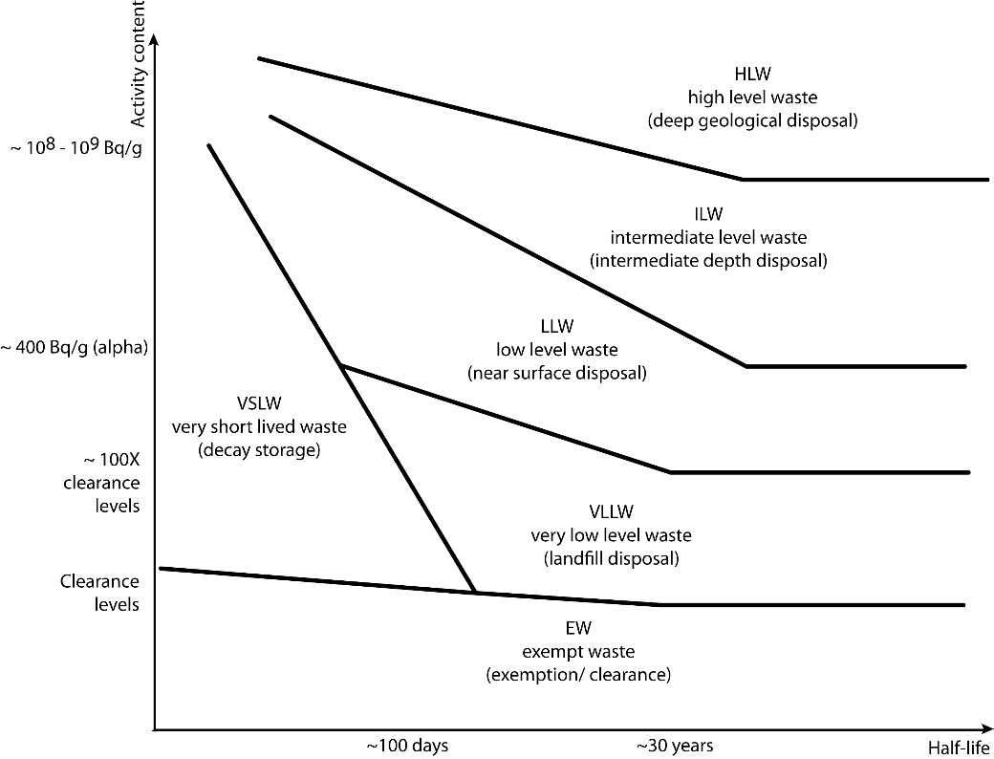
Waste classification - IAEA

Slide 20
Exempt waste (EW)
Meets the criteria for clearance, exemption or exclusion from regulatory control for radiation protection purposes.
Difference between exemption and clearance levels:
  exempt waste was never under regulatory control and
  clearance waste was under regulatory control but related to characteristics it was possible to clear it from regulatory control.
Notes:
Exempt waste (EW): Waste that meets the criteria for clearance, exemption or exclusion from regulatory control for radiation protection purposes.
To understand difference between exemption and clearance levels it should be emphasized that exempt waste was never under regulatory control and clearance waste was under regulatory control but related to characteristics it was possible to clear it from regulatory control.
20

Slide 21
Exempt waste (EW)
  IAEA Safety Standards Series, No. RS-G-1.7, Application of the Concepts of Exclusion, Exemption and Clearance (2004):
  provides explanation and guidance on the concepts of exclusion, exemption and clearance,
  gives values of activity concentration for radionuclides of both natural and artificial origin that may be used by the regulatory body for determining when control are not required.
Notes:
IAEA Safety Standards Series, No. RS-G-1.7 [3], Application of the Concepts of Exclusion, Exemption and Clearance, provides explanation and guidance on the concepts of exclusion, exemption and clearance. It gives values of activity concentration for radionuclides of both natural and artificial origin that may be used by the regulatory body for determining when controls over bulk amounts of solid material are not required or are no longer necessary.
21

Slide 22
Criteria for exemption and clearance
The values of activity concentration for artificial radionuclides are derived on the basis of generic scenarios for the recycling and disposal of waste:
  The effective doses to individuals should be of the order of 10 µSv or less in a year.
  The effective doses due to such low probability events should not exceed 1 mSv in a year.
  The regulatory body can establish different exempt levels.
Radionuclides of natural origin – The values are determined on the basis of consideration of the upper end of the worldwide distribution of activity concentrations in soil.
Notes:
Safety standard RS-G-1.7, Application of the Concepts of Exclusion, Exemption and Clearance, was based on International Basic Safety Standards for Protection against Ionizing Radiation and for the Safety of Radiation Sources, Safety Series No. 115 (1996).
In the Basic Safety Standards activity concentration for artificial radionuclides are listed considered as levels for exemption of bulk amounts of solid material. They were derived under following conditions [5]:
(a) Radiation risks arising from the cleared material are sufficiently low as not to warrant regulatory control, with no appreciable likelihood of occurrence for scenarios that could lead to a failure to meet the general criterion for clearance; or
(b) Continued regulatory control of the material would yield no net benefit, in that no reasonable control measures would achieve a worthwhile return in terms of reduction of individual doses or of health risks.
Material may be cleared (…) without further consideration provided that in all reasonably foreseeable situations the effective dose expected to be incurred by any member of the public due to the cleared material is of the order of 10 μSv or less in a year. To take into account low probability scenarios, a different criterion can be used, namely that the effective dose expected to be incurred by any member of the public for such low probability scenarios does not exceed 1 mSv in a year.
The regulatory body can establish different exempt levels from those in Basic Safety Standards on a case by case basis, providing that consideration is given to specific national circumstances. However, compliance with Basic Safety Standards provides a consensus on the boundary for unconditionally exempt or cleared material that may be transferred from one State to another (e.g. for recycling or reuse) without its being subject to regulatory control for the purposes of radiation protection.
22

Slide 23
Very short lived waste (VSLW)
Waste that can be stored for decay over a limited period of up to a few years.
Cleared from regulatory control for uncontrolled disposal, use or discharge.
Containing primarily radionuclides with very short half-lives often used for research and medical purposes.
Storage for decay is frequently used in the management of liquid and gaseous waste.
Containing short half-life radionuclide − half-lives of the order of 100 days or less.
Notes:
Waste that can be stored for decay over a limited period of up to a few years and subsequently cleared from regulatory control according to arrangements approved by the regulatory body, for uncontrolled disposal, use or discharge. This class includes waste containing primarily radionuclides with very short half-lives often used for research and medical purposes.
Storage for decay is frequently used in the management of liquid and gaseous waste containing short half-life radionuclides, which is stored until the activity concentration has fallen beneath the applicable levels for discharge to the environment.
The main criteria for the classification of waste as VSLW are the half-lives of the predominant radionuclides and the acceptability of the amounts of longer half-life radionuclides. Since the intent of storage for decay is to eventually clear the material, acceptable levels of concentration of long half-life radionuclides are set by the clearance levels. The boundary for the half-lives of predominant radionuclides cannot be specified generically because it depends on the planned duration of the storage and the initial activity concentration of the waste.
In general, the management option of storage for decay is applied for waste containing radionuclides with half-lives of the order of 100 days or less.
23

Slide 24
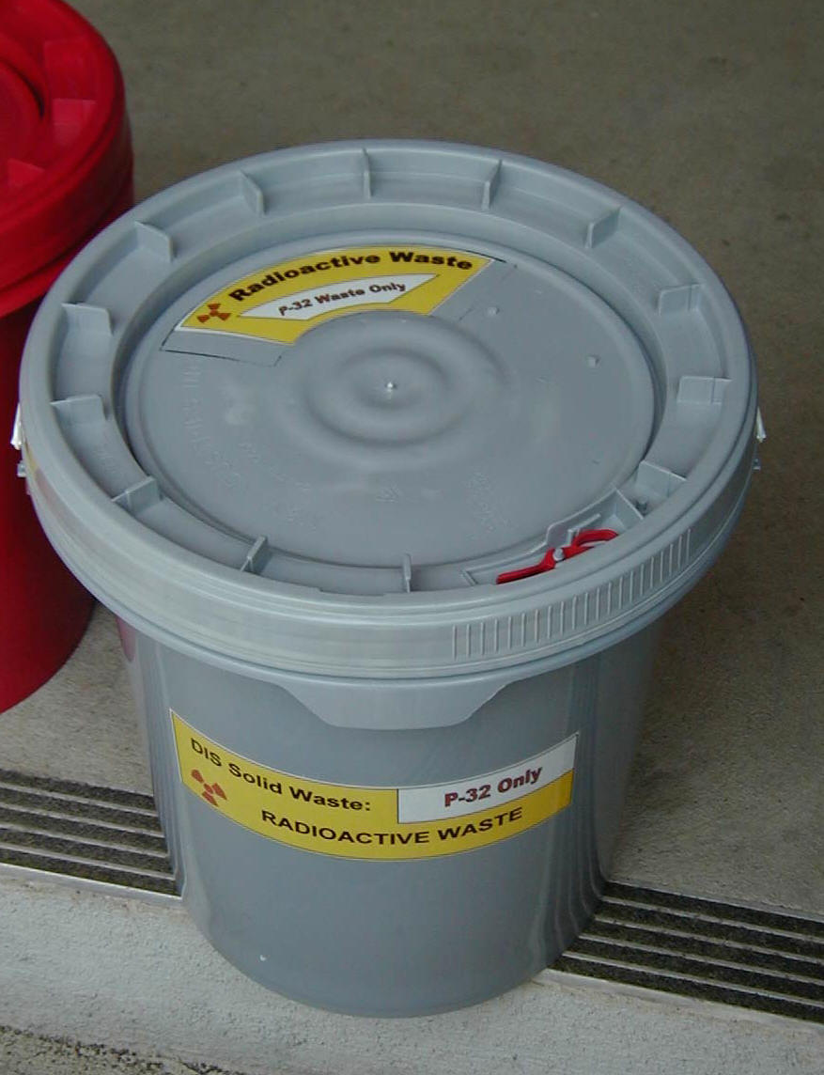
Very short lived waste (VSLW)
The classification depends on the point in time at which the waste is assigned to classification.
The classification scheme is not fixed but depends on the actual conditions of the waste in question at the time of assessment.
Notes:
The classification of waste as VSLW obviously depends on the point in time at which the waste is assigned to classification. Through radioactive decay, VSLW will move into the class of exempt waste. The classification scheme is not fixed but depends on the actual conditions of the waste in question at the time of assessment. This reflects the flexibility that radioactive decay provides for the management of radioactive waste.
24

Slide 25
Very low level waste (VLLW)
Does not meet the criteria of EW and does not need a high level of containment and isolation and is suitable for disposal in near surface landfill type facilities with limited regulatory control.
Soil and rubble with low levels of activity concentration − slightly above the levels specified for the clearance.
Acceptance criteria for engineered specialized surface landfill type facilities:
  described in the IAEA Safety Standards Series, No. RS-G-1.7,
  are developed based on a safety assessment for a specific facility,
  approved by the regulatory body.
Notes:
Waste that does not necessarily meet the criteria of EW, but that does not need a high level of containment and isolation and, therefore, is suitable for disposal in near surface landfill type facilities with limited regulatory control. Such landfill type facilities may also contain other hazardous waste. Typical waste in this class includes soil and rubble with low levels of activity concentration. Concentrations of longer lived radionuclides in VLLW are generally very limited.
Waste with levels of activity concentration slightly above the levels specified for the clearance, or waste containing naturally occurring radionuclides, originating from the mining or processing of ores and minerals.
In order to determine whether a particular type of waste can be considered to fall into the class of VLLW, acceptance criteria for engineered specialized surface landfill type facilities have to be established. The criteria are developed based on a safety assessment for a specific facility in a manner approved by the regulatory body.
25

Slide 26
Very low level waste (VLLW)
A landfill facility can safely accommodate waste containing artificial radionuclides with levels of activity concentrations one or two orders of magnitude above the levels for exempt waste, for waste containing short lived radionuclides and with limited total activity.
Up to site factors and the design, it is possible also to manage waste with higher levels of activity concentration.
Notes:
It is expected that with a moderate level of engineering and controls, a landfill facility can safely accommodate waste containing artificial radionuclides with levels of activity concentrations one or two orders of magnitude above the levels for exempt waste, for waste containing short lived radionuclides and with limited total activity. This applies as long as expected doses to the public are within criteria established by the regulatory body. In general, for waste containing naturally occurring radionuclides, acceptable levels of activity concentration will be expected to be lower than those for waste containing artificial radionuclides, in view of the long half-lives of naturally occurring radionuclides.
Depending on site factors and the design, it may still be possible to demonstrate the safety of waste with higher levels of activity concentration.
26

Slide 27
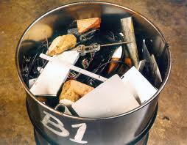
Low level waste (LLW)
Above clearance levels, but with limited amounts of long lived radionuclides.
Requires shielding but needs little or no provision for heat dissipation.
Short lived radionuclides at higher levels of activity concentration or long lived radionuclides, but only at relatively low levels of activity concentration.
Notes:
Waste that is above clearance levels, but with limited amounts of long lived radionuclides.
Radioactive waste that requires shielding but needs little or no provision for heat dissipation is classified as intermediate level waste.
This class covers a very broad range of waste. LLW may include short lived radionuclides at higher levels of activity concentration, and also long lived radionuclides, but only at relatively low levels of activity concentration. This class covers a very wide range of radioactive waste. It ranges from radioactive waste with an activity content level just above that for VLLW, that is, not requiring shielding or particularly robust containment and isolation, to radioactive waste with a level of activity concentration such that shielding and more robust containment and isolation are necessary for periods up to several hundred years.
27

Slide 28
Low level waste (LLW)
Suitable for near surface disposal.
Various design options for near surface disposal facilities:
  from simple to more complex engineered facilities,
  involve disposal at varying depths, typically from the surface down to 30 m.
Classification of waste as LLW relates to the particular radionuclides in the waste, and the various exposure pathways, such as ingestion and inhalation should be taken in account.
Notes:
As LLW may have a wide range of activity concentrations and may contain a wide range of radionuclides, there are various design options for near surface disposal facilities.
These design options may range from simple to more complex engineered facilities, and may involve disposal at varying depths, typically from the surface down to 30 m. They will depend on safety assessments and on national practices, and are subject to approval by the regulatory body.
Low concentrations of long lived radionuclides may be present in LLW. Although the waste may contain high concentrations of short lived radionuclides, significant radioactive decay of these will occur during the period of reliable containment and isolation provided by the site, the engineered barriers and institutional control.
Classification of waste as LLW should, therefore, relate to the particular radionuclides in the waste, and account should be taken of the various exposure pathways, such as ingestion (e.g. in the case of long term migration of radionuclides to the accessible biosphere in the post-closure phase of a disposal facility) and inhalation (e.g. in the case of human intrusion into the waste).
28

Slide 29
Low level waste (LLW)
The design of disposal is based on the need for institutional control so that human intrusion into the waste is prevented.
In many States it is assumed that institutional controls can be relied upon for a period of up to around 300 years.
Bounding values for LLW in terms of activity concentration levels is derived by estimating doses to exposed individuals after this period of institutional control.
Notes:
Thus, radioactive waste suitable for disposal near the surface and at intermediate depths may, in most instances, be differentiated on the basis of the need for controls over time frames for which institutional control can be guaranteed and thus human intrusion into the waste can be prevented. The suitability of a disposal facility for a particular inventory of waste is required to be demonstrated by the safety case for that facility.
In many States it is assumed that institutional controls can be relied upon for a period of up to around 300 years. Under this assumption, bounding values for low level waste in terms of activity concentration levels can be derived by estimating doses to exposed individuals after this period of institutional control.
A special situation arises for waste from the mining and processing of uranium and other materials containing significant amounts of radionuclides of natural origin, for which the activity content will not decrease significantly over such timescales. Since the management of such waste in near surface facilities is in many cases the only practicable option, longer periods of institutional control have to be postulated, with periodic safety review of the facility.
29

Slide 30
Intermediate level waste (ILW)
Waste that requires a greater degree of containment and isolation than that provided by near surface disposal.
Needs no provision, or only limited provision, for heat dissipation during its storage and disposal.
May contain long lived radionuclides, so requires disposal at greater depths, of the order of tens of metres to a few hundred metres.
Disposal at relevant depth provides a adequate period of isolation from the environment if both the natural barriers and the engineered barriers of the disposal system are selected properly. At the same time it reduces an inadvertent human intrusion.
Notes:
Intermediate level waste (ILW): Waste that, because of its content, particularly of long lived radionuclides, requires a greater degree of containment and isolation than that provided by near surface disposal. However, ILW needs no provision, or only limited provision, for heat dissipation during its storage and disposal. ILW may contain long lived radionuclides, in particular, alpha emitting radionuclides that will not decay to a level of activity concentration acceptable for near surface disposal during the time for which institutional controls can be relied upon. Therefore, waste in this class requires disposal at greater depths, of the order of tens of metres to a few hundred metres.
Disposal in a facility at a depth of between a few tens and a few hundreds of metres is indicated for ILW. Disposal at such depths has the potential to provide a long period of isolation from the accessible environment if both the natural barriers and the engineered barriers of the disposal system are selected properly.
Another important advantage of disposal at intermediate depths is that, in comparison to near surface disposal facilities suitable for LLW, the likelihood of inadvertent human intrusion is greatly reduced.
30

Slide 31
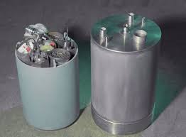
Intermediate level waste (ILW)
A precise boundary between LLW and ILW cannot be provided, as limits on the acceptable level of activity concentration will differ between individual radionuclides or groups of radionuclides.
Contents of intermediate level waste drum.
Notes:
As already stated the boundary between the LLW class and the ILW class cannot be specified in a general manner with respect to activity concentration levels, because allowable levels will depend on the actual waste disposal facility and its associated safety case and supporting safety assessment. For the purposes of communication pending the establishment of disposal facilities for ILW, the regulatory body may determine that certain waste constitutes LLW or ILW on the basis of generic safety cases.
31

Slide 32
Intermediate level waste (ILW)
Waste acceptance criteria for a near surface disposal facility is dependent on the actual design of and planning for the facility.
Restrictions on levels of activity concentration for long lived radionuclides in individual waste packages may be complemented:
  by restrictions on average levels of activity concentration,
  by emplacement of waste packages with higher levels of activity concentration at selected locations within the disposal facility.
Notes:
Waste acceptance criteria for a near surface disposal facility is dependent on the actual design of and planning for the facility (e.g. engineered barriers, duration of institutional control, site specific factors).
Restrictions on levels of activity concentration for long lived radionuclides in individual waste packages may be complemented by restrictions on average levels of activity concentration or by simple operational techniques such as emplacement of waste packages with higher levels of activity concentration at selected locations within the disposal facility.
32

Slide 33
High level waste (HLW)
Contains such large concentrations of both short and long lived radionuclides.
Typical levels of activity concentration in the range of 10⁴-10⁶ TBq/m3.
Generates significant quantities of heat from radioactive decay, and normally continues to generate heat for several centuries.
A greater degree of containment and isolation from the accessible environment − deep geological disposal, with engineered barriers.
Notes:
High level waste is defined to be waste that contains such large concentrations of both short and long lived radionuclides that, compared to ILW, a greater degree of containment and isolation from the accessible environment is needed to ensure long term safety.
Such containment and isolation is usually provided by the integrity and stability of deep geological disposal, with engineered barriers. HLW generates significant quantities of heat from radioactive decay, and normally continues to generate heat for several centuries. Heat dissipation is an important factor that has to be taken into account in the design of geological disposal facilities. HLW typically has levels of activity concentration in the range of 10⁴-10⁶ TBq/m³ (e.g. for fresh spent fuel from power reactors, which some.
33

Slide 34
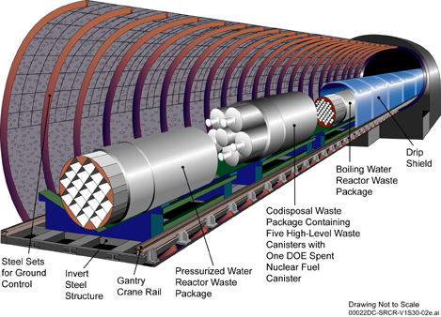
Radioactive waste – High Level Waste
Figure: High-level radioactive waste repository

Slide 35
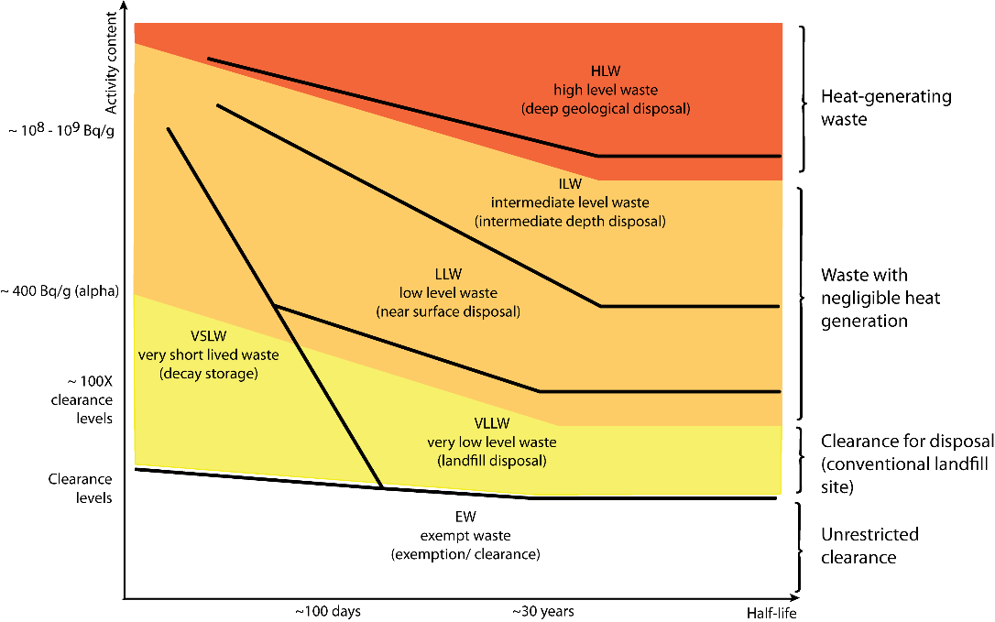
Waste classification - Germany

Slide 36
Waste classification - USA
Classification of the radioactive waste in the USA:
  Class A waste is waste that is usually segregated from other waste classes at the disposal site.
  Class B waste is waste that must meet more rigorous requirements on waste form to ensure stability after disposal.
  Class C waste is waste that not only must meet more rigorous requirements on waste form to ensure stability but also requires additional measures at the disposal facility to protect against inadvertent intrusion.
  Waste that is not generally acceptable for near-surface disposal is waste for which form and disposal methods must be different, and in general more stringent, than those specified for Class C waste. In the absence of specific requirements in this part, such waste must be disposed of in a geologic.
Notes:
Classification of the radioactive waste in the USA:
Class A waste is waste that is usually segregated from other waste classes at the disposal site.
Class B waste is waste that must meet more rigorous requirements on waste form to ensure stability after disposal.
Class C waste is waste that not only must meet more rigorous requirements on waste form to ensure stability but also requires additional measures at the disposal facility to protect against inadvertent intrusion.
Waste that is not generally acceptable for near-surface disposal is waste for which form and disposal methods must be different, and in general more stringent, than those specified for Class C waste. In the absence of specific requirements in this part, such waste must be disposed of in a geologic.
36

Slide 37
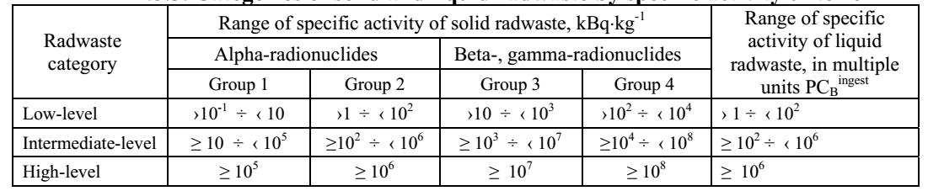
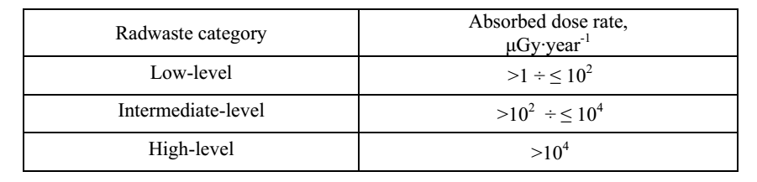
Waste classification - Ukraine
Depending on specific activity, three categories are introduced for solid and liquid radwaste
Classification of radwaste with unknown radionuclide composition and unknown specific activity by criteria of air absorbed dose at distance of 0.1 m
Notes:
According to Article 1 of the Law of Ukraine «On Radioactive Waste Management»,
radioactive waste is defined as materials and substances activity of radionuclides or
radioactive contamination of which exceeds the limits established by current standards
provided that the use of these materials and substances is not envisaged.
According to the criteria for exemption from regulatory control, in compliance with
Article 1 of the above law, radwaste is divided into long-lived and short-lived radioactive waste:
long-lived radioactive waste is waste for which the level of exemption from regulatory
control is achieved in 300 and more years after disposal;
short-lived radioactive waste is waste for which the level of exemption from regulatory
control is achieved earlier than in 300 years after disposal.
The document "Basic Sanitary Rules for Radiation Safety of Ukraine" (OSPU-2005) as
approved by the Ministry of Health of Ukraine entered into force 20 May 2005. OSPU-2005
applies to all production (industrial) activities including radwaste management.
The transition to the new classification in compliance with OSPU-2005 is currently
underway. During the transition period to the new classification criteria are applied as established
by regulatory documents “Health and Safety Rules for Design and Operation of Nuclear Power
Plants” (SPAS-88) and “Health and Safety Rules for Radioactive Waste Management” (SPORO-
85).
According to OSPU-2005, radioactive waste is divided into solid and liquid. Liquid waste
includes inorganic solutions; pulps of filtering material, sludge; salt fusion; organic liquids (oils,
solvents).
Depending on classification purposes, all radwaste is divided into types, groups, categories
and kinds.
The radwaste types based on acceptance criteria for waste disposal in near-surface
(shallow) repositories or in stable deep geological formations are identified according to Table
B.5.1.
Із урахуванням нового стандарту безпеки МАГАТЕ GSG-1 Classification of Radioactive Waste, міжнародного досвіду та рекомендації місій IRRS-2008 та IRRS-2010, в Україні ініційовано перегляд та вдосконалення класифікації РАВ. Метою цього є впровадження системи класифікації РАВ відповідно до способу остаточного захоронення РАВ. В рамках інструменту співробітництва ЄК INSC, протягом 2010-2012 років реалізовано проект U4.01/08-С "Improvement of the radwaste classification system in Ukraine". Продовжується робота щодо імплементації отриманих в рамках цього проекту рекомендацій у національну нормативно-правову систему.
У перехідний період до введення в дію оновленої системи класифікації, для потреб експлуатації діючих об’єктів, застосовується існуюча класифікація РАВ. Разом з тим, здійснення розробок та досліджень стосовно подальшого розвитку системи захоронення РАВ, розробки концепцій захоронення, ведеться із урахуванням пропозицій щодо вдосконалення класифікації РАВ, які рекомендовані в рамках проекту U4.01/08-С.

Slide 38
NATURE AND SOURCES OF RADIOACTIVE WASTE - Learning objectives
Get broad overview of the types of radioactive waste.
Get broad overview of the generating liquid radioactive waste.
Get broad overview of the generating solid radioactive waste.
Get broad overview of the generating gaseous radioactive waste.

Slide 39
Types of radioactive waste
The radioactive waste may be solid, liquid or gaseous.
Levels of activity concentration range from extremely high levels (spent fuel) to very low levels.
Radioactive Waste could come from:
  mining and minerals processing
  NPPs
  institutional activities
  defence programmes and weapons production related waste
Notes:
Many activities involving the use of radionuclides and the production of nuclear energy, including all the steps in the nuclear fuel cycle, result in the generation of radioactive waste. Radioactive waste may also be generated by other activities such as the medical or industrial use of radioisotopes and sealed radiation sources, by defence and weapons programmes, and by the (mostly large scale) processing of mineral ores or other materials containing naturally occurring radionuclides, which in some cases have to be managed as radioactive waste. Examples of the last include the processing of phosphate ore and oil or gas exploration. Radioactive waste also arises from intervention activities, which are necessary after accidents or to remediate areas affected by past practices.
The radioactive waste may be solid, liquid or gaseous. Levels of activity concentration range from extremely high levels associated with spent fuel and residues from fuel reprocessing to very low levels associated with radioisotope applications in laboratories, hospitals, etc. Equally broad is the spectrum of half-lives of the radionuclides contained in the radioactive waste.
39

Slide 40
Waste from mining and minerals processing
Mining activities lead to large amounts of materials that contain uranium or thorium in small quantities.
Mine tailings resulting from the mining of uranium and thorium ores contain elevated levels of naturally occurring radionuclides and are required to be managed as radioactive waste.
  Tailings from processing contain significant amounts of hazardous chemicals (copper, arsenic, molybdenum and vanadium) − considered in assessing the safety of planned management options.
Notes:
Mining activities lead to the extraction of ore that is sufficiently rich to justify processing, and also of relatively large amounts of materials that contain uranium or thorium in such small quantities that further processing is not economically justified. The mined materials not subjected to further processing constitute the mine tailings generally accumulated as waste piles, usually in proximity to the mines. Mine tailings resulting from the mining of uranium and thorium ores generally contain elevated levels of naturally occurring radionuclides and are required to be managed as radioactive waste for radiation protection purposes and safety reasons. The richer ores from which uranium or thorium are to be separated are sent to mills for processing, which generally entails crushing and chemical processing. After removal of the uranium, the residues (the mill tailings) contain little of the parent nuclide of the decay chain of the mined element, but they still contain most of its decay products. Some of the daughter products may be more susceptible to leaching and emanation from the tailings than from the original ore. In addition, tailings from processing contain significant amounts of hazardous chemicals, including heavy metals such as copper, arsenic, molybdenum and vanadium; these need to be considered in assessing the safety of planned management options.
40

Slide 41
Waste from mining and minerals processing
Radioactive waste containing naturally occurring radionuclides also arise from the extraction and/or processing of other materials that happen to be rich in naturally occurring radioactive materials;
  phosphate minerals,
  mineral sands,
  some gold-bearing rocks,
  coal and hydrocarbons, and
  contain long lived radionuclides at relatively low concentrations.
The concentration of the radionuclides in these waste streams may exceed the levels for exempt waste so the regulatory control is necessary to ensure safety.
Notes:
Similar types and quantities of radioactive waste containing naturally occurring radionuclides also arise from the extraction and/or processing of other materials that happen to be rich in naturally occurring radioactive materials; these materials include phosphate minerals, mineral sands, some gold-bearing rocks, coal and hydrocarbons, and contain long lived radionuclides at relatively low concentrations. The concentration of the radionuclides in these waste streams may exceed the levels for exempt waste. In recent years an increasing awareness has arisen that action is required to reduce doses due to exposure to such waste (often referred to as NORM and TENORM) and that regulatory control is necessary to ensure safety. The characteristics of such waste, however, are sufficiently different from those of other waste that specific regulatory considerations may be required. Of particular relevance are the long half-lives of radionuclides present and the usually large volumes of materials arising.
41

Slide 42
Waste from NPPs
Low level waste and intermediate level waste from operations:
  purification, conversion and enrichment of uranium and fabrication,
  filter materials, lightly contaminated trash, and residues from recycling,
  uranium and plutonium (in the case of mixed oxide fuel) are characteristic radionuclides in this waste.
Notes:
Low level waste and intermediate level waste from operations: Purification, conversion and enrichment of uranium and fabrication of fuel elements generates waste in the form of filter materials, lightly contaminated trash, and residues from recycling. Uranium and plutonium (in the case of mixed oxide fuel) are characteristic radionuclides in this waste.
42

Slide 43
Waste from NPPs
  Waste from decommissioning of nuclear installations:
  radioactive waste that may vary greatly in type, level of activity concentration, size and volume, and may be activated or contaminated,
  solid materials such as process equipment, construction materials, tools and soils,
  the largest volumes of waste will mainly be VLLW and LLW,
  to reduce the amount, decontamination of materials is widely applied.
Notes:
Waste from decommissioning of nuclear installations: At the end of the useful life of a nuclear installation, administrative and technical actions are taken to allow the removal of some or all of the regulatory requirements from the facility. The activities involved in decontamination and dismantling of a nuclear facility and the clean-up of the site will lead to the generation of radioactive waste that may vary greatly in type, level of activity concentration, size and volume, and may be activated or contaminated. This waste may consist of solid materials such as process equipment, construction materials, tools and soils. The largest volumes of waste from the dismantling of nuclear installations will mainly be VLLW and LLW. To reduce the amount of radioactive waste, decontamination of materials is widely applied.
43

Slide 44
Waste from NPPs
High level waste:
  spent nuclear fuel generates significant heat and is usually placed in storage pools,
  spent fuel can be subjected to a reprocessing, disposal or long term storage.
Liquid HLW:
  stored in tanks prior to its eventual solidification,
  general agreement that liquid HLW needs to be transformed into a solid,
  somwhere liquid HLW has been stored in tanks for time periods now extending to several decades.
Notes:
High level waste: Spent nuclear fuel contains significant amounts of fissile materials, other actinides and fission products. It generates significant heat when freshly removed from the reactor, and is usually placed in storage pools, generally located within the reactor building. Eventually the spent fuel will be removed and subjected to a management option chosen from among a few possibilities: reprocessing, disposal and long term storage.
Liquid HLW is generally stored in tanks prior to its eventual solidification (vitrification is the approach currently used). While there is general agreement that liquid HLW needs to be transformed into a solid, there are a number of sites where liquid HLW has been stored in tanks for time periods now extending to several decades. Most liquid HLW subjected to such long term storage has been generated by activities in defence programmes.
44

Slide 45
Waste from institutional activities
  Waste from research reactors:
  generated by research reactors,
  some disused radioactive sources,
  does not meet the waste acceptance criteria of near surface disposal facilities.
Notes:
The waste generated by research reactors and from some disused radioactive sources is particularly significant because, owing to its level of activity concentration and to the half-lives of the radionuclides, it does not meet the waste acceptance criteria of near surface disposal facilities.
45

Slide 46
Waste from institutional activities
  Waste from research facilities:
  hot cell chains, glove box chains or pilot plants for checking fuel fabrication processes, for fuel reprocessing, and for post-irradiation examinations, as well as their analytical laboratories,
  presence of non-negligible amounts of long lived alpha emitters,
  generally belongs to the ILW, in some circumstances, to the HLW class,
  the type and volume of waste dependent on the research conducted.
Notes:
Research facilities (e.g. hot cell chains, glove box chains) or pilot plants for checking fuel fabrication processes (particularly the fabrication of mixed uranium plutonium oxides, known as MOX), for fuel reprocessing (particularly advanced schemes), and for post-irradiation examinations, as well as their analytical laboratories, generate types of waste that, often, are different from the typical waste generated by industrial plants. Owing to the presence of non-negligible amounts of long lived alpha emitters, waste from research facilities generally belongs to the ILW class and even, in some circumstances, to the HLW class. Research activities take place at facilities such as research reactors and accelerators, and include laboratory activities. The type and volume of waste generated by research activities is dependent on the research conducted.
46

Slide 47
Waste from the production and use of radioisotopes
Production of radioisotopes:
  type and volume of waste generated depends on the radioisotope and its production method,
  the volume of radioactive waste generated from these activities is small but the levels of activity concentration may be significant.
Disused sealed sources:
  sealed sources are widely used in medical and industrial applications,
  large and highly concentrated amount of single radionuclide,
  require emplacement at greater depths and fall within ILW class.
Notes:
Production of radioisotopes: The type and volume of waste generated depends on the radioisotope and its production method. Generally, the volume of radioactive waste generated from these activities is small but the levels of activity concentration may be significant.
Disused sealed sources: Sealed sources are widely used in medical and industrial applications. They usually contain large and highly concentrated amount of single radionuclide. At the end of the use they may still be hazardous and require appropriate management. Due to the level of activity they may not meet the waste acceptance criteria for near surface disposal facilities. These sources require emplacement at greater depths and fall within ILW (or even HLW) class.
47

Slide 48
Waste from defence programmes and weapons production related waste
In the early days of nuclear programs large quantity of radioactive waste was generated.
A lot of HLW is still in storages awaiting solidification.
At the end of last century considerable amount of nuclear weapons were dismantled.
Blending of highly enriched uranium or plutonium with natural uranium to produce uranium or mixed uranium-plutonium fuel:
  for commercial reactors or
  storing this material for future disposal with HLW or spent fuel.
Notes:
In the early days of nuclear programs large quantity of radioactive waste was generated. A lot of HLW is still in storages awaiting solidification.
At the end of last century considerable amount of nuclear weapons were dismantled. This typically involves blending of highly enriched uranium or plutonium with natural uranium to produce uranium or mixed uranium-plutonium fuel for commercial reactors or storing this material for future disposal with HLW or spent fuel.
48

Slide 49
Contaminations
Radioactive residues deposited on Earth’s surface from:
  nuclear weapon testing,
  accidents at nuclear facilities and
  some past practices like uranium mining.
The waste arising from remediation operations will have to be managed as radioactive waste − stabilized in situ or disposed of in appropriate disposal facilities.
Notes:
Residues from nuclear weapon testing, accidents at nuclear facilities and some past practices like uranium mining have resulted in radioactive residues deposited on Earth’s surface. The waste arising from remediation operations will have to be managed as radioactive waste and be either stabilized in situ or disposed of in appropriate disposal facilities.
49

Slide 50
TREATMENT - Learning objectives
Get broad overview of the waste treatment and conditioning.
Get broad overview of the techniques for the waste treatment and conditioning.

Slide 51
Radioactive waste treatment
Treatment and conditioning allow that waste meets the acceptance criteria for disposal and the requirements for any associated activities for handling, transport and storage.
Notes:
The main objectives of treatment and conditioning of the LILW is to produce a waste product that meets the acceptance criteria for disposal and the requirements for any associated activities for handling, transport and storage.
The treatment of LILW may include:
The reduction in volume of the waste (by incineration of combustible waste, compaction of solid waste and segmentation or disassembly of bulky waste components or equipment);
The removal of radionuclides (by evaporation or ion exchange for liquid waste streams and filtration of gaseous waste streams);
Change of form or composition (by chemical processes such as precipitation, flocculation and acid digestion as well as chemical and thermal oxidation);
Change of the properties of the waste.
51

Slide 52
Radioactive waste treatment include:
  The reduction in volume of the waste (by incineration of combustible waste, compaction of solid waste and segmentation or disassembly of bulky waste components or equipment);
  The removal of radionuclides (by evaporation or ion exchange for liquid waste streams and filtration of gaseous waste streams);
  Change of form or composition (by chemical processes such as precipitation, flocculation and acid digestion as well as chemical and thermal oxidation);
  Change of the properties of the waste.
Notes:
The main objectives of treatment and conditioning of the LILW is to produce a waste product that meets the acceptance criteria for disposal and the requirements for any associated activities for handling, transport and storage.
The treatment of LILW may include:
The reduction in volume of the waste (by incineration of combustible waste, compaction of solid waste and segmentation or disassembly of bulky waste components or equipment);
The removal of radionuclides (by evaporation or ion exchange for liquid waste streams and filtration of gaseous waste streams);
Change of form or composition (by chemical processes such as precipitation, flocculation and acid digestion as well as chemical and thermal oxidation);
Change of the properties of the waste.
52

Slide 53
Radioactive waste treatment
General concerns relating to treatment and conditioning of waste:
  Limitation of the external and internal exposure of the workers due to external irradiation and airborne radionuclides;
  The avoidance of fires and explosions;
  The minimization of the leakage of liquid waste;
  The minimization of releases of volatile or airborne radionuclides;
  The prevention of criticality, particularly in circumstances in which waste containing fissile isotopes might be concentrated owing to processing, such as precipitation or the incineration of waste.
Notes:
General concerns relating to treatment and conditioning of the LILW include:
Limitation of the external and internal exposure of the workers due to external irradiation and airborne radionuclides;
The avoidance of fires and explosions;
The minimization of the leakage of liquid waste;
The minimization of releases of volatile or airborne radionuclides;
The prevention of criticality, particularly in circumstances in which waste containing fissile isotopes might be concentrated owing to processing, such as precipitation or the incineration of waste.
53

Slide 54
Radioactive waste treatment
Treatment of contaminated liquid aims at reducing concentrations to the levels that can be safely discharged.
Reducing of concentration achieved by a variety of processes such as ion exchange, evaporation, and chemical treatment, decanting-centrifuging and reverse osmosis ultrafiltration.
The residues from these processes are called wet wastes.
Notes:
Treatment of contaminated liquid aims at reducing concentrations to the levels that can be safely discharged. The concentration can be achieved by a variety of processes such as ion exchange, evaporation, and chemical treatment, decanting-centrifuging and reverse osmosis ultrafiltration. The residues from these processes are called wet wastes.
54

Slide 55
Waste treatment techniques
Treatment process is dependent on the level of activity and the type of waste and national approach to waste management.
Waste treatment techniques:
Segmentation Compaction Incineration Cementation Bituminisation | Vitrification Ion Exchange Evaporation Membrane separation Polymer fixation
Notes:
The choice of treatment process(es) is dependent on the level of activity and the type (classification) of waste and national approach to waste management. Some of the treatment process (oftenly used) are provided.
Waste treatment techniques:
Segmentation,
Compaction,
Incineration,
Cementation,
Bituminisation,
Vitrification,
Ion Exchange,
Evaporation,
Membrane separation,
Polymer fixation.
55

Slide 56
WASTE PACKAGING - Learning objectives
Get broad overview of the waste packaging.
Get broad overview of the waste package specification.
Get broad overview of the waste acceptance criteria.

Slide 57
Waste packaging
Waste package is designed as the major engineered component for ensuring containment and providing safety functions.
A principal unit used as a reference for controlling information, record keeping, and making decisions with due considerations of the interdependencies, impacts and information needs at various stages in radioactive waste management.
IAEA terminology − a waste package is the product of conditioning that includes the waste form and any container (packaging) prepared in accordance with requirements for handling, transport, storage and disposal.
Notes:
In the management of radioactive waste, a waste package is designed as the major engineered component for ensuring containment and providing safety functions. It also represents a principal unit used as a reference for controlling information, record keeping, and making decisions with due considerations of the interdependencies, impacts and information needs at various stages in radioactive waste management.
According to the IAEA terminology, a waste package is the product of conditioning that includes the waste form and any container (packaging) prepared in accordance with requirements for handling, transport, storage and disposal.
57

Slide 58
Waste packaging
Due to their multiple functions and the great importance of waste packages its design, fabrication, inspection and testing, quality assurance, maintenance of records are extremely important.
Requirements for safe disposal of waste packages is an unavoidable prerequisite for the entire waste management system.
Waste acceptance requirements for disposal should be approved by national authorities considering also international standards, best practices, and recommendations.
Notes:
Due to their multiple functions and the great importance of waste packages its design, fabrication, inspection and testing, quality assurance, maintenance of records are extremely important.
Given that disposal is considered a final step of safe waste management, developing and implementing requirements for safe disposal of waste packages is an unavoidable prerequisite for the entire waste management system. The definition and quantification of waste acceptance requirements for disposal should be approved by national authorities considering also international standards, best practices, and recommendations.
58

Slide 59
Waste packaging
Package specifications must reflect and comply with the applicable disposal waste acceptance requirements.
The waste acceptance requirements are either specified by the regulatory body or developed by the repository operator on the basis of safety assessments, considering:
  radiological criteria,
  the conditions of operation,
  the planned duration of active institutional control and
  the characteristics of natural and engineered systems.
Notes:
Package specifications must reflect and comply with the applicable disposal waste acceptance requirements.
The waste acceptance requirements are either specified by the regulatory body or developed by the repository operator on the basis of safety assessments, considering radiological criteria, the conditions of operation, the planned duration of active institutional control and the characteristics of natural and engineered systems.
59

Slide 60
Waste packaging
In the absence of a national disposal facility and waste acceptance requirements, radioactive waste still needs proper packaging as a basic safety requirement for:
  waste conditioning,
  interim storage and
  transportation.
Notes:
Even in the absence of a national disposal facility and waste acceptance requirements, radioactive waste still needs proper packaging as a basic safety requirement for waste conditioning, interim storage and transportation.
60

Slide 61
Waste acceptance criteria
Specify the radiological, mechanical, physical, chemical and biological characteristics of waste packages and unpackaged waste which need to be processed, stored or disposed of.
Adherence to the waste acceptance criteria is essential for the safe handling and storage/disposal of waste packages and unpackaged waste.
The operators’ procedures for the reception of waste have to contain provisions for safely managing waste that fails to meet the acceptance criteria.
Notes:
Waste acceptance criteria specify the radiological, mechanical, physical, chemical and biological characteristics of waste packages and unpackaged waste which need to be processed, stored or disposed of; or their radionuclide content or activity limits, their heat output and the properties of the waste form and packaging.
Adherence to the waste acceptance criteria is essential for the safe handling and storage of waste packages and unpackaged waste during normal operation, for safety during possible accident conditions and for the long term safety of the subsequent disposal of the waste.
The operators’ procedures for the reception of waste have to contain provisions for safely managing waste that fails to meet the acceptance criteria.
61

Slide 62
Waste acceptance criteria
In interaction between waste package characteristics and repository design should be considered:
  Generic requirements are defined (a) on the basis of the national radioactive waste disposal policy; (b) on general information on the types and quantities of waste expected to be generated; and (c) on the availability of potential sites.
  Site selection and site characterization follow to determine the characteristics of the disposal site.
  Specific waste acceptance requirements are established.
Development of waste acceptance requirements must encompass disposal of all types of radioactive waste.
Notes:
The development of requirements for radioactive waste disposal might be performed with respect to international safety standards and recommendations. Reasonable assurance for the safety of each individual disposal system can be provided in a stepwise approach, based on site specific safety assessments of the operational and post-closure phases. The following three stages can be distinguished with an interaction between waste package characteristics and repository design:
First, generic requirements are defined (a) on the basis of the national radioactive waste disposal policy; (b) on general information on the types and quantities of waste expected to be generated; and (c) on the availability of potential sites.
Site selection and site characterization follow to determine the characteristics of the disposal site.
Finally, specific waste acceptance requirements are established.
Depending upon the specific national situation, the development of waste acceptance requirements must encompass disposal of all types of radioactive waste. They shall emphasize the importance of site selection, the system consisting of geology/repository/waste packages, the multi barrier concept, and the use of state-of-the-art technology.
62

Slide 63
Waste acceptance criteria
Requirements for disposal address relevant waste package parameters − imposed by the licensing and supervising authorities.
Broad range of different waste packages or individual types of waste packages.
Requirements permit some freedom of judgement and approaches:
  determined by a site specific safety assessment,
  safety of the repository in its operational and post-closure phases must be evaluated quantitatively,
  including the derivation of requirements on the design of the disposal facility, as well as on the waste packages.
Notes:
Requirements for disposal may address relevant waste package parameters as well as any additional requirements imposed by the licensing and supervising authorities. They may either cover a broad range of different waste packages or be established for individual types of waste packages.
The waste acceptance requirements permit some freedom of judgement and approaches. This may be determined by a site specific safety assessment, within the scope of which the required safety of the repository in its operational and post-closure phases must be evaluated quantitatively, including the derivation of requirements on the design of the disposal facility, as well as on the waste packages.
63

Slide 64
Waste acceptance criteria
The protection objective of disposal:
  achieved within an iterative process,
  considering detailed information through its various phases of investigation, conceptual planning, detailed design, and performance assessment, consequently assuming more stable forms.
Waste acceptance requirements are derived from the safety case.
Waste acceptance requirements:
  the general requirements of the waste packages,
  specific requirements on the waste forms, the waste containers, on individual radionuclides and activity, on documentation and record keeping, and finally on the delivery of waste packages.
Notes:
In any case, the protection objective of disposal can only be achieved within an iterative process drawing together more detailed information as the repository project progresses through its various phases of investigation, conceptual planning, detailed design, and performance assessment, consequently assuming more stable forms. Thus, the original qualitative waste acceptance requirements (guidelines) may assume a more quantitative character (criteria). Quantitative waste acceptance requirements for a near surface or geological repository can be defined at an advanced stage of development based on the results of a site specific safety assessment. Such an assessment should consider the geological situation, the technical concept/design of the repository, its scheduled mode of operation and the waste packages to be emplaced.
Waste acceptance requirements might be prepared in such a way that they either define the safety related envelope for the waste intended for disposal or focus on specific requirements on individually characterized radioactive wastes. Anyhow they are derived from the safety case.
Waste acceptance requirements might first describe the general disposal related aspects and requirements of the waste packages and then develop into more specific requirements on the waste forms, the waste containers, on individual radionuclides and activity, on documentation and record keeping, and finally on the delivery of waste packages.
64

Slide 65
Waste acceptance criteria
Basic requirements on radioactive waste to be disposed:
  Prohibition of mixing non-radioactive waste with radioactive waste;
  Compliance with the requirements of the site specific safety assessment.
General requirements on waste packages:
  Surface dose rate;
  Surface contamination;
  Hazardous substances content limitation;
  Absence of overpressure;
  Waste package mass.
Notes:
Thus, depending upon the near surface or geological repository, waste acceptance requirements might be structured as follows:
Basic requirements on radioactive waste to be disposed:
Prohibition of mixing non-radioactive waste with radioactive waste,
Compliance with the requirements of the site specific safety assessment,
General requirements on waste packages:
Surface dose rate,
Surface contamination,
Hazardous substances content limitation,
Absence of overpressure,
Waste package mass.
65

Slide 66
Waste acceptance criteria
Requirements on waste forms:
  Basic requirements (e.g. only solid or solidified waste, no free liquid);
  Specific requirements (e.g. stabilization (dispersion inhibition), heterogeneity, chemical restrictions);
  With immobilization binder (e.g. bitumen, polymer or cement);
  Without immobilization binder (e.g. radioactivity and radionuclide restrictions).
Requirements on waste containers:
  Basic requirements (e.g. geometric shape and dimensions, stackability);
  Specific requirements (e.g. mechanical stability, thermal resistance, leak tightness, shielding function);
  Inner containers (e.g. surface coating, seals, vents, void space restrictions).
Notes:
Requirements on waste forms:
Basic requirements (e.g. only solid or solidified waste, no free liquid),
Specific requirements (e.g. stabilization (dispersion inhibition), heterogeneity, chemical restrictions),
With immobilization binder (e.g. bitumen, polymer or cement),
Without immobilization binder (e.g. radioactivity and radionuclide restrictions).
Requirements on waste containers:
Basic requirements (e.g. geometric shape and dimensions, stackability),
Specific requirements (e.g. mechanical stability, thermal resistance, leak tightness, shielding function),
Inner containers (e.g. surface coating, seals, vents, void space restrictions).
66

Slide 67
Waste acceptance criteria
Limitations of activity:
  Permissible activities for individual radionuclides;
  Permissible total activity per waste package;
  Permissible total alpha and beta/gamma emitter activity;
  Declaration of radionuclide-specific activities/total activities per waste package.
Delivery of waste packages:
  Compliance with transport regulations;
  Permits/documentation including record keeping;
  Marking of waste packages;
  Requirements on transport containers.
Notes:
Limitations of activity:
Permissible activities for individual radionuclides,
Permissible total activity per waste package,
Permissible total alpha and beta/gamma emitter activity,
Declaration of radionuclide-specific activities/total activities per waste package.
Delivery of waste packages:
Compliance with transport regulations,
Permits/documentation including record keeping,
Marking of waste packages,
Requirements on transport containers.
67

Slide 68
Waste package specification
Description of waste packages prepared for disposal.
Separate package specifications for each type of waste package, describe the nature, content and performance.
Meet the waste acceptance requirements for disposal facilities.
The approval and acceptance of waste package specifications:
  done by the regulatory authority,
  in agreement with the operator of the repository or disposal facility.
Notes:
Waste package specifications consist of a quantitative description of waste packages prepared for disposal. Separate waste package specifications should be developed for each type of waste package. The intention is to demonstrate that the waste packages will meet the waste acceptance requirements for disposal facilities. Typically, waste package specifications will describe the nature, content and performance of each type of waste package and provide a link between the supporting research and development (R&D) and package production.
Depending on the national legislation, a formal statement on the approval and acceptance of waste package specifications should be done by the regulatory authority and in agreement with the operator of the repository or disposal facility. In the case of waste package specifications dealing with waste to be returned from foreign countries, official statements between the authorities of those countries are to be exchanged.
In compliance with a given regulatory context, contractual negotiations on waste processing and waste disposal provide an ideal opportunity to clarify waste acceptance requirements and to define waste package specifications that must be followed. Important contractual relationships will exist between the waste generator and conditioner on the one side and the operator of the repository on the other side, even if such a facility is not yet available. Close consultation between the waste generator and the repository operator will help take account of any aspects of the wastes that are not the concern of the generators when they operate their facilities. For example, long lived activation products do not influence operation of a power plant but can be very significant for disposal.
68

Slide 69
Waste package specification
The preparation, approval and implementation require careful definition of the task, realistic programming and appropriate allocation of resources.
Must be reviewed regularly and updated to ensure that they continue to define the characteristics of the waste package.
New versions of waste package specifications must be issued when significant changes to the requirements have occurred.
Waste package records reflect the current waste package specifications including any subsequent modifications or upgrades
Notes:
As with any interactive project, the preparation, approval and implementation of waste package specifications require careful definition of the task, realistic programming and appropriate allocation of resources to ensure efficient progress. This will allow cost benefits to be realized, especially through avoidance of backfitting, (both of equipment and control measures) to comply with requirements that existed but were earlier ignored
Waste package specifications must be reviewed regularly and updated as required (in accordance with the quality assurance system) to ensure that they continue to define the characteristics of the waste package. New versions of waste package specifications must be issued when significant changes to the requirements have occurred. It is imperative that waste package records reflect the waste package specifications in place at the time of package design and construction, including any subsequent modifications or upgrades.
69

Slide 70
Waste package specification
The specifications may be split into a number of sections. A suitable structure would cover the following items:
  general introduction;
  waste container and associated items;
  waste composition and inactive feed materials;
  formulation envelope, process description and conditions;
  waste product storage conditions;
  guaranteed parameters of the conditioning process;
  summary of the supporting R&D, identifying parameters that show the waste package is consistent with waste acceptance requirements;
  QA and QC arrangements;
  additional or supplementary information;
  figures and diagrams.
Notes:
The specifications may be split into a number of sections. A suitable structure would cover the following items:
general introduction;
waste container and associated items;
waste composition and inactive feed materials;
formulation envelope, process description and conditions;
waste product storage conditions;
guaranteed parameters of the conditioning process;
summary of the supporting R&D, identifying parameters that show the waste package is consistent with waste acceptance requirements;
QA and QC arrangements;
additional or supplementary information;
figures and diagrams.
70

Slide 71
STORAGE AND DISPOSAL - Learning objectives
Get broad overview of the waste storage.
Get broad overview of the waste disposal.

Slide 72
Storage of the radioactive waste
The storage facilities − concrete buildings with wall thickness from 30 cm up to about one meter, depending on the activity of waste.
LLW waste packages transferred with a shielded lift truck.
Remote handling by overhead crane is usually provided for ILW waste packages.
Interim storage facilities are mostly on the location of existing nuclear facility, or if there is several nuclear facilities they can share one storage facility.
Notes:
As disposal of waste packages is not made immediately after conditioning in majority cases, interim storage of waste is required. It must be arranged in such a way as to ensure the operational safety and the suitability of waste packages for disposal after retrieval from the storage facility.
The storage facilities are, in most cases, concrete buildings with wall thickness from 30 cm up to about one meter, depending on the activity of waste. In storages for LLW, waste packages are normally transferred with a shielded lift truck while in storages for ILW remote handling by overhead crane is usually provided for waste packages. Interim storage facilities are mostly on the location of existing nuclear facility, or if there is several nuclear facilities they can share one storage facility.
72

Slide 73
Storage of the radioactive waste
The design and operation of waste storage should consider:
  Limitation of radiation exposure during handling of waste packages;
  Limitation of external dose rate outside the storage and potential releases from the storage;
  Maintenance of appropriate environmental conditions (temperature, humidity) in the storage;
  Fire protection if combustible waste is present;
  Prevention of unauthorized access;
  Inspection, monitoring and identification of waste packages; and
  Feasibility of retrieval of waste packages.
Notes:
In the design and operation of waste storage, consideration should be given to:
Limitation of radiation exposure during handling of waste packages;
Limitation of external dose rate outside the storage and potential releases from the storage;
Maintenance of appropriate environmental conditions (temperature, humidity) in the storage;
Fire protection if combustible waste is present;
Prevention of unauthorized access;
Inspection, monitoring and identification of waste packages; and
Feasibility of retrieval of waste packages.
73

Slide 74
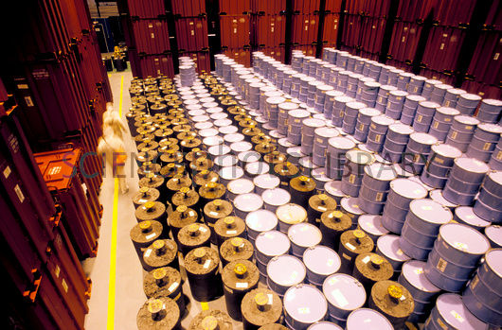
Waste storage

Slide 75
Disposal of the radioactive waste
The disposal refers to the emplacement of radioactive waste into a facility or a location with no intention of retrieving the waste.
Containing the waste by means of passive engineered and natural features to isolate it from the accessible biosphere to the extent necessitated by the associated hazard.
The term disposal implies that retrieval is not intended; it does not mean that retrieval is not possible.
Various types of disposal facility − different degrees of containment and isolation capability appropriate to the radioactive waste.
Notes:
The disposal refers to the emplacement of radioactive waste into a facility or a location with no intention of retrieving the waste. Disposal options are designed to contain the waste by means of passive engineered and natural features and to isolate it from the accessible biosphere to the extent necessitated by the associated hazard. The term disposal implies that retrieval is not intended, but it does not mean that retrieval is not possible.
A number of design options for disposal facilities have been developed and various types of disposal facility have been constructed in many countries and are in operation. These design options have different degrees of containment and isolation capability appropriate to the radioactive waste that they will receive.
75

Slide 76
Disposal of the radioactive waste
The specific aims of disposal are:
  To contain the waste;
  To isolate the waste from the accessible biosphere and to reduce substantially the likelihood of, and all possible consequences of, inadvertent human intrusion into the waste;
  To inhibit, reduce and delay the migration of radionuclides at any time from the waste to the accessible biosphere;
  To ensure that the amounts of radionuclides reaching the accessible biosphere due to any migration from the disposal facility are such that possible radiological consequences are acceptably low at all times.
Notes:
The specific aims of disposal are:
To contain the waste;
To isolate the waste from the accessible biosphere and to reduce substantially the likelihood of, and all possible consequences of, inadvertent human intrusion into the waste;
To inhibit, reduce and delay the migration of radionuclides at any time from the waste to the accessible biosphere;
To ensure that the amounts of radionuclides reaching the accessible biosphere due to any migration from the disposal facility are such that possible radiological consequences are acceptably low at all times.
76

Slide 77
Waste disposal
Option | Examples
Specific landfill disposal: in a facility similar to a conventional landfill facility for industrial refuse | Such a facility may be designated as a disposal facility for very low level radioactive waste (VLLW) with low concentrations or quantities of radioactive content
Near-surface disposal at ground level, or in caverns below ground level (at depths of tens of metres) | Implemented for LLW in many countries, including Czech Republic, Finland, France, Japan, Netherlands, Spain, Sweden, UK and USA. Implemented in Finland and Sweden for LLW and short-lived ILW.
Disposal of intermediate level waste | Depending on its characteristics, (ILW can be disposed of in different types of facility. Disposal could be by emplacement in a facility constructed in caverns, vaults or silos at least a few tens of metres below ground level and up to a few hundred metres below ground level. It could include purpose built facilities and facilities developed in or from existing mines. It could also include facilities developed by drift mining into mountainsides or hillsides, in which case the overlying cover could be more than 100 m deep.
Notes:
The following table sets out the different examples of management options. When considering these, it should be noted that the suitability of an option or idea can be dependent on the waste form, volume and radioactivity of the waste.
77

Slide 78
Waste disposal
Geological disposal (at depths between 250m and 1000m) | Most countries with high-level and long-lived radioactive waste have investigated deep geological disposal and it is official policy in various countries (variations also include multinational facilities). Implemented in USA for defence-related ILW. Preferred sites for HLW/spent fuel selected in France, Sweden, Finland and USA Geological repository site selection process commenced in UK and Canada.
Borehole disposal: a facility consisting of an array of boreholes, or a single borehole. | A borehole disposal facility is designed further disposal of only relatively small volumes of waste, in particular disused sealed radioactive sources. A design option for very deep boreholes, several kilometres deep, has been examined for the disposal of solid high level waste and spent fuel, but this option has not been adopted for a disposal facility by any country.
Disposal of mining and mineral processing waste | Disposal usually on or near the ground surface, but the manner and the large volumes in which the waste arises, its physicochemical form and its content of long lived radionuclides of natural origin distinguish it from other radioactive waste. The waste is generally stabilized in situ and covered with various layers of rock and soil.

Slide 79
Near-surface disposal facilities at ground level
On or below the surface where the protective covering is of the order of a few metres thick.
Waste containers are placed in constructed vaults and when full the vaults are backfilled.
Eventually they will be covered and capped with an impermeable membrane and topsoil.
Incorporate some form of drainage and possibly a gas venting system.
Notes:
Near-surface disposal facilities at ground level:
These facilities are on or below the surface where the protective covering is of the order of a few metres thick. Waste containers are placed in constructed vaults and when full the vaults are backfilled. Eventually they will be covered and capped with an impermeable membrane and topsoil. These facilities may incorporate some form of drainage and possibly a gas venting system.
79

Slide 80
Near-surface disposal facilities in caverns below ground level
Underground excavation of caverns.
At a depth of several tens of metres below the Earth's surface.
Accessed through a drift.
Notes:
Near-surface disposal facilities in caverns below ground level: Unlike near-surface disposal at ground level where the excavations are conducted from the surface, shallow disposal requires underground excavation of caverns but the facility is at a depth of several tens of metres below the Earth's surface and accessed through a drift.
80

Slide 81
Disposal facilities – Near surface
Affected by long-term climate changes (such as glaciation) and this effect must be taken into account when considering safety as such changes could cause disruption of these facilities.
Typically used for LLW and ILW with a radionuclide content of short half-life (up to about 30 years).
Notes:
These facilities are affected by long-term climate changes (such as glaciation) and this effect must be taken into account when considering safety as such changes could cause disruption of these facilities. This type of facility is therefore typically used for LLW and ILW with a radionuclide content of short half-life (up to about 30 years).
81

Slide 82
Deep geological disposal
Waste in the underground repositories in stable geological formations.
Combination of engineered and natural barriers (rock, salt, clay).
No obligation to actively maintain the facility is passed on to future generations.
Multi-barrier concept prevents the radionuclides reaching humans and the environment by providing barriers:
  waste packaging,
  the engineered repository and
  the geology.
Notes:
The long timescales over which some of the waste remains radioactive led to the idea of deep geological disposal in underground repositories in stable geological formations. Isolation is provided by a combination of engineered and natural barriers (rock, salt, clay) and no obligation to actively maintain the facility is passed on to future generations. This is often termed a multi-barrier concept, with the waste packaging, the engineered repository and the geology all providing barriers to prevent the radionuclides from reaching humans and the environment.
82

Slide 83
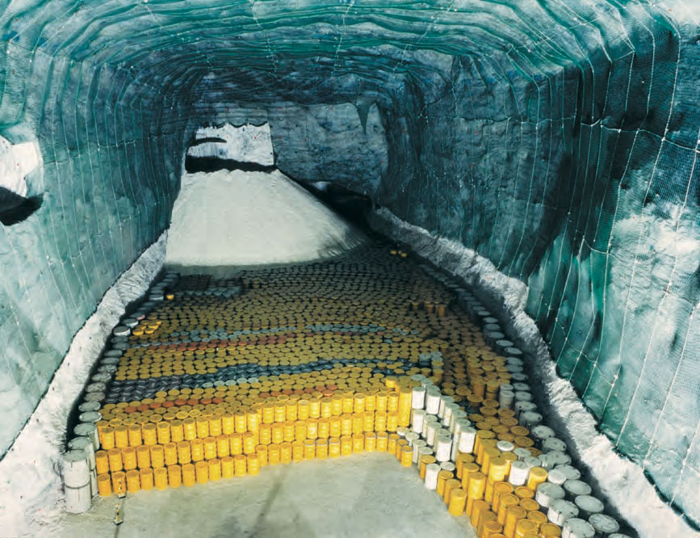
Deep geological disposal
A repository − mined tunnels or caverns for placing waste.
In some cases the waste containers are surrounded by a material such as cement or clay to provide another barrier (buffer and/or backfill).
Morsleben repository (ERAM, Germany)
Notes:
A repository is comprised of mined tunnels or caverns into which packaged waste would be placed. In some cases (wet rock) the waste containers are then surrounded by a material such as cement or clay (usually bentonite) to provide another barrier (called buffer and/or backfill).
83

Slide 84
Deep geological disposal
Waste container materials and design and buffer/backfill depending on the type of waste and the nature of the host rock-type available.
Excavation of a deep underground repository is limited to accessible locations, to rock units that are reasonably stable and without major groundwater flow.
Depths of between 250 m and 1000 m.
At a depth greater than 1000 m, excavations may become increasingly difficult and correspondingly expensive.
Deep geological disposal of HLW is the only final solution.
Notes:
The choice of waste container materials and design and buffer/backfill material varies depending on the type of waste to be contained and the nature of the host rock-type available.
Excavation of a deep underground repository using standard mining or civil engineering technology is limited to accessible locations (under land or nearshore), to rock units that are reasonably stable and without major groundwater flow, and to depths of between 250 m and 1000 m. At a depth greater than 1000 m, excavations may become increasingly difficult and correspondingly expensive.
Deep geological disposal of HLW is the only final solution. However for several countries remains the preferred option for waste management of long-lived ILW radioactive waste, including Argentina, Australia, Belgium, Czech Republic, Finland, Japan, Netherlands, Republic of Korea, Russia, Spain, Sweden, Switzerland and USA. Plans for disposal of spent fuel are well advanced in Finland, Sweden and the USA. In Canada and the UK, deep disposal has been selected and the site selection process has commenced.
84

Slide 85
Summary
The following issues were discussed
Radioactive Waste Classification System
Radioactive Waste Treatment
Radioactive Waste Packaging
Radioactive Waste Storage and Disposal

Slide 86
Questions
Explain in your own words the goal of the national radioactive waste strategy.
Explain the main elements of this strategy
15-26 January - 19-30 March 2018
86

Slide 87
Key points
15-26 January - 19-30 March 2018
87
It is important that all types of radioactive waste are correctly classified to ensure that appropriate disposal measures.
Country should have National strategy for radioactive waste management

Slide 88
References
15-26 January - 19-30 March 2018
88
Joint Convention on the Safety of Spent Fuel Management and on the Safety of Radioactive Waste Management.
GSG-1 Classification of Radioactive Waste (2009)
GSR Part 5 Predisposal Management of Radioactive Waste (2009)
WS-G-6.1 Storage of Radioactive Waste (2006)
SSR-5 Disposal of Radioactive Waste (2011)
GS-G-3.3 The Management System for the Processing, Handling and Storage of Radioactive Waste (2008)

Slide 89
Thank you!
Notes:
Thank you!

Slide 90
Additional information about waste treatment techniques

Slide 91
Waste treatment techniques
Treatment process is dependent on the level of activity and the type of waste and national approach to waste management.
Waste treatment techniques:
Segmentation; Compaction; Incineration; Cementation; Bituminisation; | Vitrification; Ion Exchange; Evaporation; Membrane separation; Polymer fixation.
Notes:
The choice of treatment process(es) is dependent on the level of activity and the type (classification) of waste and national approach to waste management. Some of the treatment process (oftenly used) are provided.
Waste treatment techniques:
Segmentation,
Compaction,
Incineration,
Cementation,
Bituminisation,
Vitrification,
Ion Exchange,
Evaporation,
Membrane separation,
Polymer fixation.
91

Slide 92
Segmentation
Used to facilitate the packaging of bulky waste batches, such as worn-out equipment and components.
Oxygen burning, various sawing methods, hydraulic shearing, abrasive cutting, and plasma arc cutting can be used for segmentation.
Prevention of particulate contamination should be considered in the choice of method.
Notes:
Segmentation and other size reduction techniques are used to facilitate the packaging of bulky waste batches, such as worn-out equipment and components. Oxygen burning, various sawing methods, hydraulic shearing, abrasive cutting, and plasma arc cutting can be used for segmentation. Prevention of particulate contamination should be considered in the choice of method.
92

Slide 93
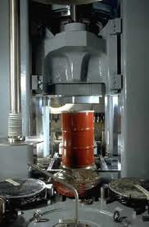
Compaction
Reduces waste volume by a factor from 2 to 10.
Available also in mobile units and normally used for further compaction of waste drums; the crushed drums are then enclosed into an over-pack.
HEPA filters to prevent spread of contamination.
Notes:
Compaction can reduce waste volume by a factor from 2 to 10.
Compactors vary from balers and in-drum compactors with modest pressing force up to 2000 t super compactors. The latter are available also in mobile units and they are normally used for further compaction of waste drums; the crushed drums are then enclosed into an over-pack. The compactors are usually equipped with HEPA filters to prevent spread of contamination.
93

Slide 94
Incineration
Requires waste segregation but can produce volume reduction factors up to 100 for the combustible portion of the waste.
Located at nuclear research centres.
Afterburners to decompose combustible gases.
Ash from incinerators is normally grouted in wet cement in order to immobilize radioactive substances and to provide shielding.
Secondary waste is generated in the form of filters.
Notes:
Incineration requires waste segregation but can produce volume reduction factors up to 100 for the combustible portion of the waste. Incinerators have capacities from some tens to a few hundreds of kg/h.
They are normally central facilities, located e.g. at nuclear research centres. The more advanced incinerators have afterburners to decompose combustible gases.
Ash from incinerators is normally grouted in wet cement in order to immobilize radioactive substances and to provide radiation shielding. Secondary waste is generated in the form of filters.
94

Slide 95
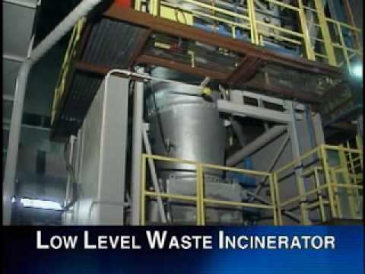
Incineration

Slide 96
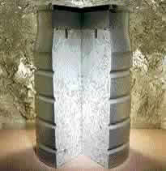
Cementation
Widely used technique available even in mobile units.
Applicable to a variety of wet wastes (50 % of water).
Volume of cemented waste is typically twofold in comparison with the original waste volume.
Cemented waste is compatible with many types of environmental conditions and generates favourable alkaline conditions in a repository.
Notes:
Cementation is widely used technique and is available even in mobile units.
It is applicable to a variety of wet wastes and the process occurs at room temperature. Water content of the waste can be 50 % or even more but, on the other hand, the volume of cemented waste is typically twofold in comparison with the original waste volume. The product has good mechanical stability and radiation resistance while the leach resistance is satisfactory.
Cemented waste is compatible with many types of environmental conditions and, in addition, cement generates favourable alkaline conditions in a repository.
96

Slide 97
Bituminisation
Applicable to most wet wastes that can be dewatered.
The process requires high operating temperature and involves certain fire risks.
A volume reduction factor of two is typically achieved via bituminisation.
The mechanical stability is poor (plasticity, swelling); radiation resistance is satisfactory for waste from NPPs and the leach resistance ranges from poor to satisfactory.
Notes:
Bituminisation is applicable to most wet wastes that can be dewatered. Extruder, dryer-mixer and film evaporator processes are in use in a number of countries. The process requires high operating temperature and involves certain fire risks. A volume reduction factor of two is typically achieved via bituminisation. The product characteristics vary according to the characteristics of waste and process. The mechanical stability is poor (plasticity, swelling); radiation resistance is satisfactory for LILW from NPPs and the leach resistance ranges from poor to satisfactory. Also bituminized waste is compatible with most environmental conditions.
97

Slide 98
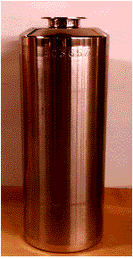
Vitrification
One immobilisation of high-level waste.
Requires the formation of an insoluble, solid waste form that will remain stable for many thousands of years.
Stability of ancient glass for thousands of years highlights the suitability of borosilicate glass as a matrix material.
Most high-level wastes arise in a liquid form from the reprocessing of spent fuel.
Notes:
Vitrification is the immobilisation of high-level waste (HLW). It requires the formation of an insoluble, solid waste form that will remain stable for many thousands of years. In general borosilicate glass has been chosen as the medium for dealing with HLW. The stability of ancient glass for thousands of years highlights the suitability of borosilicate glass as a matrix material.
Most high-level wastes other than spent fuel itself arise in a liquid form from the reprocessing of spent fuel. To allow incorporation into the glass matrix this waste is initially calcined (dried) which turns it into a solid form. This product is then incorporated into molten glass in a stainless container and allowed to cool, giving a solid matrix. The containers are then welded closed and are ready for storage and final disposal.
98

Slide 99
Ion Exchange
Mobile ions from an external solution are exchanged for ions that are electrostatically bound to the functional groups contained within a solid matrix.
By taking advantage of the fact that, under certain conditions, ion exchange media have a greater affinity for certain ionic species than for others, a separation of the species can be made.
Depending on the type of the functional group, ion exchangers can be divided into several types: strong acidic, strong basic, weak acidic and weak basic.
Notes:
Ion Exchange is a process in which mobile ions from an external solution are exchanged for ions that are electrostatically bound to the functional groups contained within a solid matrix. When the functional groups are negatively charged the exchange will involve cations and when they are positively charged they involve anions. By taking advantage of the fact that, under certain conditions, ion exchange media have a greater affinity for certain ionic species than for others, a separation of these species can be made
Depending on the type of the functional group, ion exchangers can be divided into several types: strong acidic, strong basic, weak acidic and weak basic.
99

Slide 100
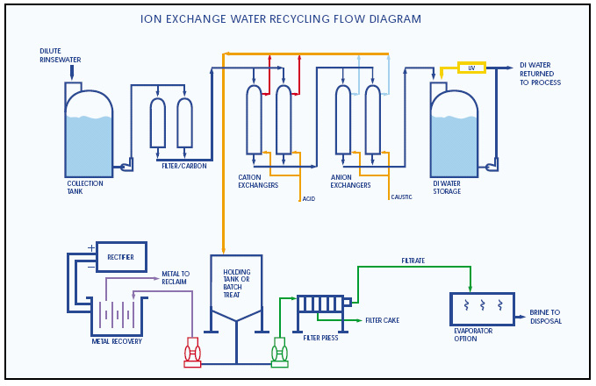
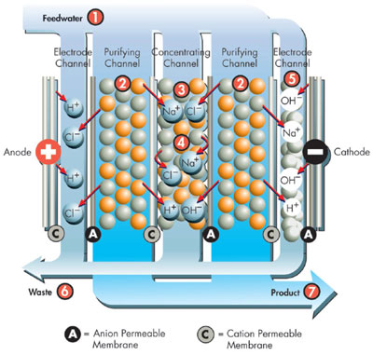
Ion Exchange
To achieve the removal of both positively and negatively charged ions from solution, a mixture of cation and anion resins in a mixed bed system is often used.
Ion exchange process.
Ion Exchange water recycling flow diagram.
Notes:
To achieve the removal of both positively and negatively charged ions from solution, a mixture of cation and anion resins in a mixed bed system is often used.
100

Slide 101
Evaporation
A solution is concentrated via boiling away the solvent, resulting in the reducing of the waste volumes and in reducing of the amount of radioactive nuclides in liquid effluents.
For radioactive wastes that require the high degree of separation between volatile and nonvolatile components or for wastes that are not amenable to treatment by low-temperature operations.
The elements involved in evaporator design are heat transfer, vapour-liquid separation, volume reduction, and energy utilization:
  decontamination of the liquid is important objective and
  heating costs and volume reduction are relatively less important.
Notes:
Evaporation is the process by which a solution is concentrated via boiling away the solvent, resulting in the reducing of the waste volumes and in reducing of the amount of radioactive nuclides in liquid effluents. Evaporation is usually used for radioactive wastes that require the high degree of separation between volatile and nonvolatile components that it offers or for wastes that are not amenable to treatment by low-temperature operations such as precipitation, filtration, and ion exchange. An evaporator consists basically of a device to transfer heat for boiling the solution and a device to separate the vapor phase from the liquid phase. The principal elements involved in evaporator design are heat transfer, vapor-liquid separation, volume reduction, and energy utilization. In the design of evaporators for concentrating radioactive liquids, vapor-liquid separation is the most important factor because decontamination of the liquid is the most important objective and heating costs and volume reduction are relatively less important.
101

Slide 102
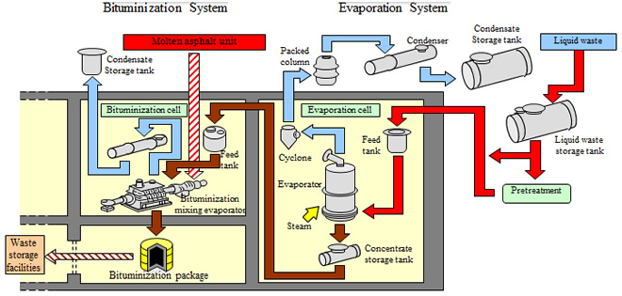
Evaporation
A small amount of entrainment can contaminate the condensed vapour and reduce the decontamination to unsatisfactorily low levels.
Bituminization and evaporation
Notes:
A small amount of entrainment can contaminate the condensed vapour and reduce the decontamination to unsatisfactorily low levels.
102

Slide 103
Membrane separation
Differ from one another in the type and configuration of the membrane, the mechanism of trans-membrane transport for various water solution components, the nature of the process driving force:
  pressure,
  temperature,
  electrical potential gradient, etc...
The pressure driven separation processes have been preferred by the nuclear industry.
Notes:
A wide variety of membrane separation processes exist which differ from one another in the type and configuration of the membrane, the mechanism of trans-membrane transport for various water solution components, the nature of the process driving force (pressure, temperature, electrical potential gradient, etc..) and other features. While some processes are well proven in full scale industrial applications (pressure driven), others are experimental, in development, or are in transition from the development stage to industrial use. The pressure driven separation processes have been preferred by the nuclear industry over other membrane processes as they are well proven (more than 30 years) in wastewater treatment applications and are capable to cover the entire removal spectrum from large particles to ionic species. Pressure driven membrane separation processes differ mainly in the pore size of their membranes, which makes a particular membrane effective for the removal of a specific range of impurities. In pressure driven membrane systems the pressure of the feed solution permits passage of the major portion of the solution through a semi-permeable membrane. Pressure driven membrane processes may be viewed as sophisticated filtration methods capable of separating fine particles, molecules and ions in solution. Pressure driven membrane processes can be operated in cross-flow mode or in dead end (conventional) mode
103

Slide 104
Osmosis and reverse osmosis
Osmosis − two solutions of different concentrations are separated by a semipermeable membrane that allows the solvent to pass through it.
The reverse osmosis is separation of dissolved ions and small molecules that contaminate aqueous solutions.
The pressure exerted to force the flow of water into the less concentrated solution must exceed the osmotic pressure of the feed solution.
Notes:
Osmosis is the spontaneous transport (diffusion) of solvent that takes place when two solutions of different concentrations are separated by a semipermeable membrane that allows the solvent (but not dissolved species) to pass through it. The term reverse osmosis is reserved for separation of dissolved ions and small molecules that contaminate aqueous solutions. The pressure exerted to force the flow of water into the les concentrated solution must exceed the osmotic pressure of the feed solution. Reverse osmosis is used to remove all ionic species and thus has the smallest membrane pore size.
104

Slide 105
Polymer fixation
Applicable to most wet wastes.
Not widely used due to the high price of the fixation agent.
Takes place at room temperature but good control of the chemical reactions is necessary.
The waste may contain excess water and polymerization results in a slight volume increase.
The leach resistance of polymer products is generally higher than that of cement products.
Polymers can, over long times, degrade to form complexants which may increase the mobility of some radionuclides.
Notes:
Polymer fixation is applicable to most wet wastes but is not widely used due primarily to the high price of the fixation agent. Polymers like polystyrene, polyester epoxy and vinyl-ester have been used. The process takes place at room temperature but good control of the chemical reactions is necessary. The waste may contain excess water and polymerization results in a slight volume increase. The leach resistance of polymer products is generally higher than that of cement products. Polymers can, over long times, degrade to form complexants which may increase the mobility of some radionuclides.
105

Slide 106
Treatment of organic and other liquids
Organic and other liquids, which cannot be treated by generic methods, can be absorbed into special granular or powdered agents, resulting in a semi-solid end product.
Ion exchange resins and filter masses of low activity may also be dewatered and packed into durable containers as such, without immobilization.
Notes:
Organic and other liquids, which cannot be treated by means of the methods discussed above, can be absorbed into special granular or powdered agents, resulting in a semi-solid end product. Ion exchange resins and filter masses of low activity may also be dewatered and packed into durable containers as such, without immobilization.
106

